Slide 1
MyQ Online Shopping
The technical solution design presentation

Slide 2
Overview of content
The business overview of online shopping site
The solution’s feature.
The system diagram and components
The design philosophy and microservices’ feature allocation
Data flow diagrams samples
Entity Relationship Diagrams
API Definition and Implementation

Slide 3
Business requirement overview
The MyQ shopping is an online service for goods retailers listing their products in organization of MyQ Catalogue for sale. The retailers set products’ price themself.
Customers do browsing/searching products in catalogue, comparing the price between retailers of single interested product and select. They can add the product with desired quantity to a shopping cart then checking out.
Checking out is to place an order to specific retailers of selected products.
The new order information will be notified to the retailers or called to the retailer’s online shopping API (if he/she has) for order processing & delivery
The payment method is cash on delivery due to limited startup time.
The delivery process is out of scope but only delivery status update.
The Inventory and available stock monitoring is out of scope.

Slide 4
The solution’s features highlight
Product Catalogue with Retailer’s price management
Shopping Cart
Retailer & Customer Mgt.
Order Mgt. & Delivery Tracking
Non-functional features:
  Retailer Sign-up and Login
  Retailer Integration for product price update, accepting order.
  Third-party support of API for delivery status update.
  Mobile App and Browser Support
Functional features and non-functional features

Slide 5
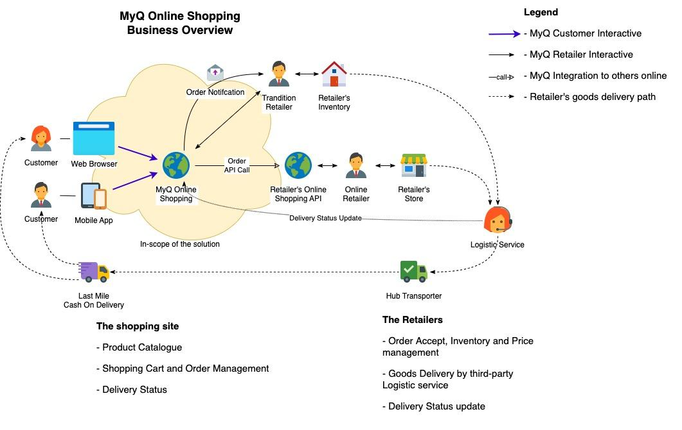
The business system illustration

Slide 6
Technical Guidance
A cloud first, clean room solution: AWS has been chosen.
Microservices and event-driven architecture.
High responsive, High scalable.
Browser and Mobile Application for client access.
Java-based technology, containerized environment prefered

Slide 7
Design philosophy
Microservice: try to separate the concern of each business feature into services.
Services could be built on any teams’ handy framework.
Setup a boundary for Microservices by their Data Model:
  Aggregate object identified by public-ids for external interface.
  Entities (with ids) and Value objects for internal data structure of the service.
  Status (or object state) is stored as enum/flag field or existence of “linked row”.
Loose constraint of the relationship between entities. There are Application controlled external key references (not enforce the constraint).
Still using RDBMS/ORM or non-ORM for better “time-to-market” development.
Utilize JSON/XML data type of modern database for schemaless data: replacing EAV model for dynamic fields.

Slide 8
Microservices scoping
The system should be divided into following components:
  Product catalogue and price management
  Shopping cart: quotation and customer onboarding and check out process
  Order management and delivery tracking
  Retailer sign-up and admin UI
Each component covers one step of e-commerce sale pipeline: browsing products, product selection and quotation, make order, delivery and support.
The service can directly served client request without a “composited service” in front. There are session/tokens for authentication and authorization.
Events of a service will be processed by functions of the service by sharing job queues, or system events, or asynchronouse invoking.

